Slide 1
Tweet Project
Team 12
Hongyu Xin, Xinran Zhao, Catherine Zhou, Devyani Ashok Mardia
We have done the pre-presentation to cohort
1 /16

Slide 2
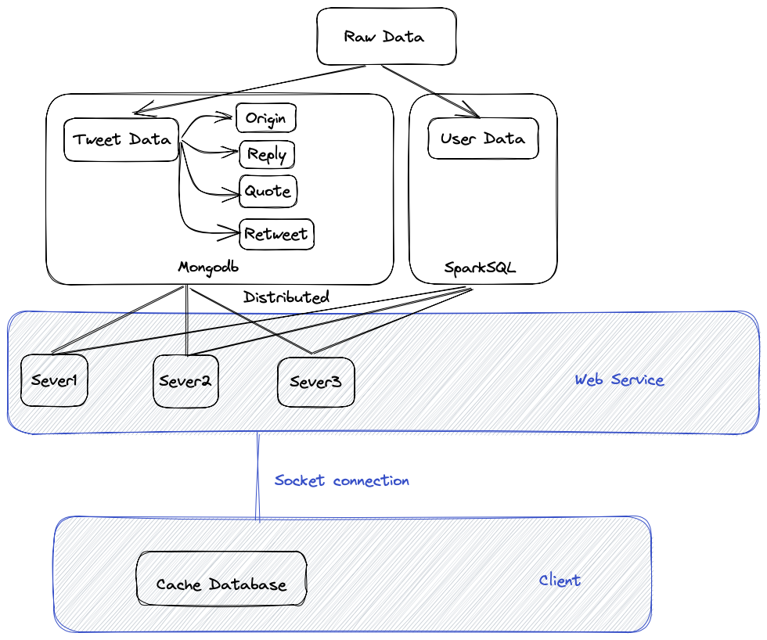
Framework
Server
{Mongodb : tweet data
Sparksql : user data}
Query → Content
Client
{cache_database}
2 /16

Slide 3


Data insertion
We split the dataset into 4 mongodb tables and 1 sql table
Nested data
def insert_data(new_data):
If no nested data:
Update database
Else:
insert_data(new_data)
Add reference(which tweet reply,retweet,quote the tweet)
3 /16

Slide 4
Index
Tweet_id
collection.create_index([("tweet_id", -1)])
Default Index is created on ID when we insert data into the database.
Allowing the database to quickly locate and retrieve specific data.
4 /16

Slide 5
Text Indices: Text and Hashtags
Creating text indices to search inside the tweets/ documents text
Ignores stop words, common words like a, an, the, etc. based on the language
Supports natural language and provides better processing by considering root words and their different grammar forms
Provides facility to score the searches and even modify the score algorithm to facilitate better sorting mechanism for our results
5 /16

Slide 6
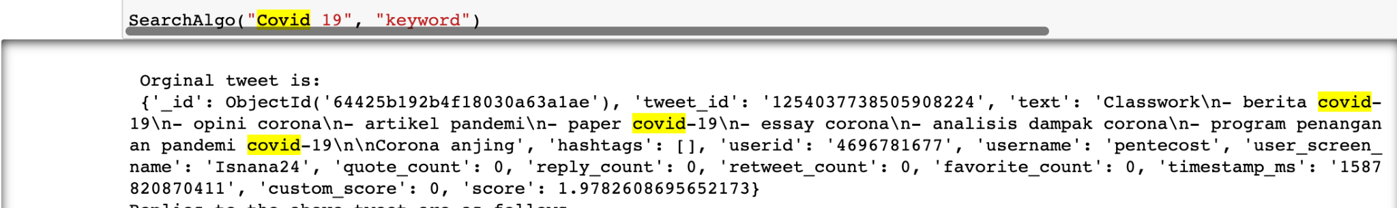
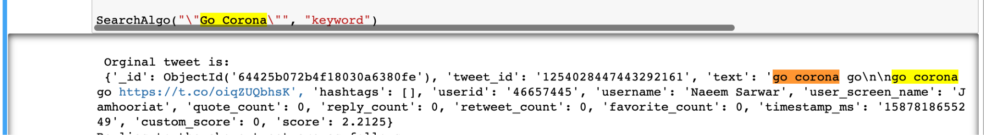
Tweet Search based on keyword with scoring
Search for a specific string text
6 /16

Slide 7
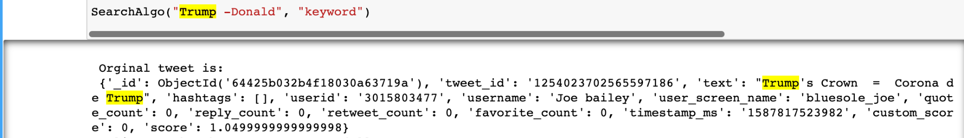
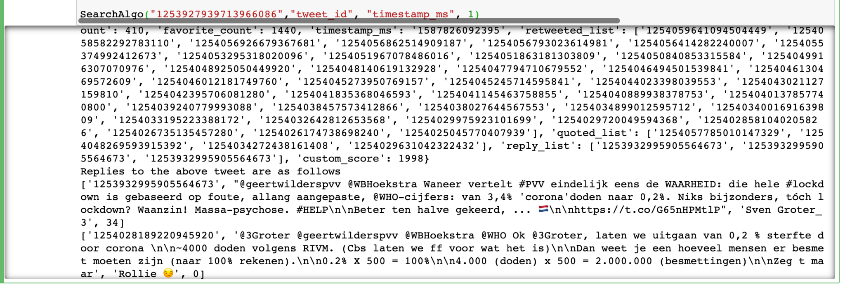
Recursive comment searching
Tweet Search based keyword as Trump but stop word Donald

Slide 8
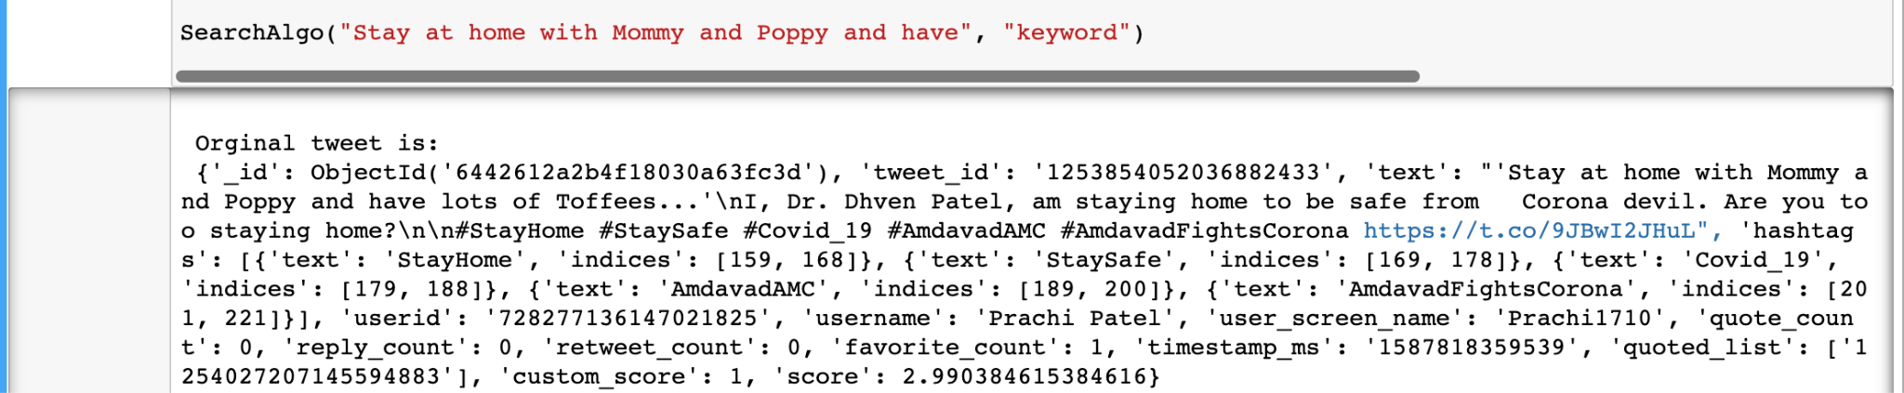
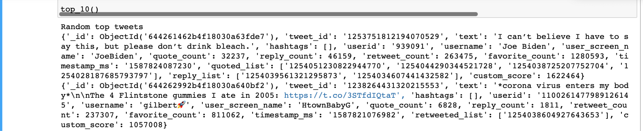
Exact tweet matching for the first result
Top 10 tweets based on the custom_score/ranking
7 /16

Slide 9
Rank algorithm and reorganize the searching result
Dataset is partitioned, cached and indexed to gain the best possible performance.
Search supports Keyword, Sentences, Stop words, Hashtags, Timestamp and User information
Functionality to sort the results based on various important variables: Timestamps, Text scores, Most liked, Retweeted and quoted tweets.
8 /16

Slide 10
Continued
One of the most important points was also to retrieve the best possible results having the highest “custom_rank”
This is calculated based on weighted average of favourite, retweeted and quoted counts.
We provide the users with a way to find all the comments/replies to a tweet by retrieving all the replies of replies for any given tweet.
Advanced searching is provided to find keywords in comments as well in case the results were limited for a keyword

Slide 11
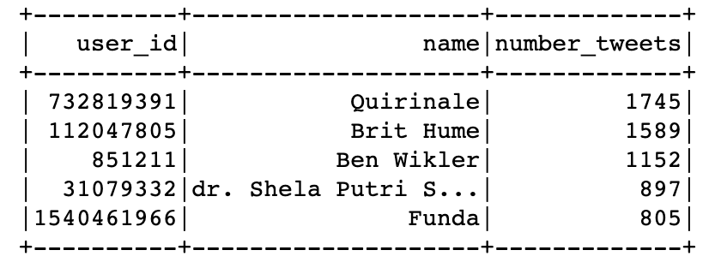
User data
Insert & Search
Insert User information
Design table schema
Collect user information from nested tweets data
101916 lines in corona-out-3
Top 5 most frequently users
Use Recursion function
187443 user records in total
90336 unique users
Insert in table
Set user_id as primary key, put all tweet_id in a list
Identity
id, name, location…
⭐️Basic
User data
influency
followers_count, friends_count…
Profile
9 /16

Slide 12
User data
Insert & Search
Insert User information
Design table schema
Collect user information from nested tweets data
Perform insertion
After scanning all lines in file 😄 takes seconds
While scanning lines in file 😭 takes hours
Set user_id as primary key, put all tweet_id in a list
Keep the latest information
Compare the timestamp
Update follower_count, favourites_count…
10 /16

Slide 13
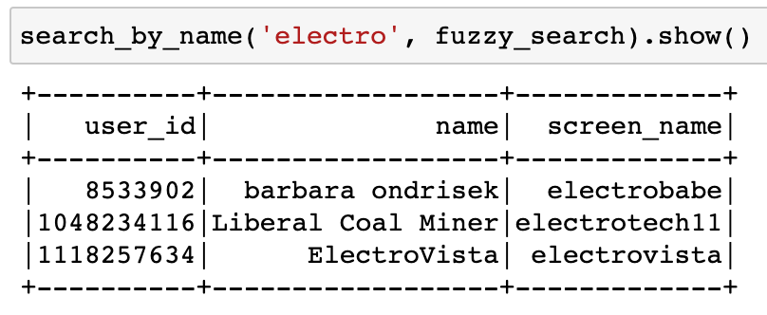
User data
Insert & Search
Search for name or screen_name
Fuzzy search
Find approximate matches that are similar to the search query
Exact search
Find only the exact matches for the search query.
🔍 electro
Search by exact_search: No record shows up
Since there is no user named ‘electro’ exactly
11 /16

Slide 14
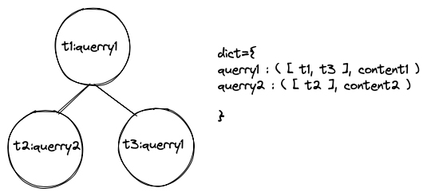
cache database
Used a Min Heap and a dict to implement the database.
Heap:
Use the insert timestamp as key.
The query is the value.
Dict:
Use the query as key.
[Timestamp] as value1.
Content as value2.
12 /16

Slide 15
cache database
New query in,
Search in the cache,
If in return, else go to the server,
What ever where we get the data,
Push it into cache after the searching.
13 /16

Slide 16
cache database
New searching push : O(n) = log(n+1)
Old searching pop : O(n) = log(n+1)
Searching : O(n) = 1
Trade off :
If a user searching same query several times, other query would be pop out.
14 /16

Slide 17
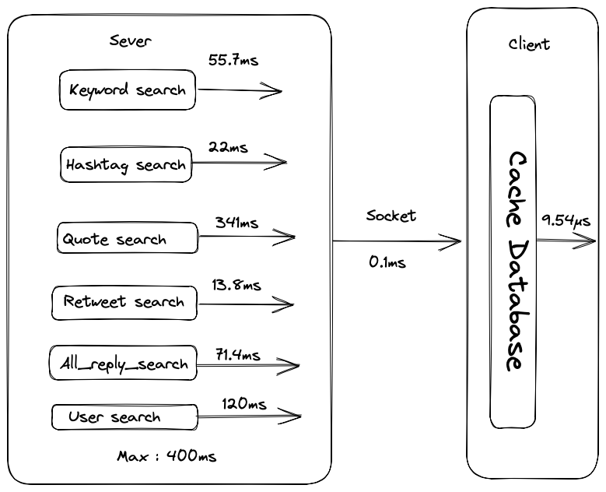
time
Time cost is less than 0.5s,
It would support fluent user experience.
Number of output is limited to 100, time cost is showed.
15 /16

Slide 18
Thank You
16 /16

